Slide 1
SAP Cloud Platform Integration Overview

Slide 2
Table of Contents
1
Cloud Computing in SAP & On-Premise Vs On-demand Solutions.
2
Cloud-as-a-Service (Saas, Paas, Iaas)
2
3
SAP Cloud Platform
SAP Cloud Platform Integration – Overview
4
5
SAP CPI vs SAP PI/PO– When to use what?
SAP CPI to On-premise connectivity
6
Integration Solution Cloud vs. On-Premise
7
8
Different commercial models and which one is right for your client ?
9
SAP Cloud Platform Integration Service

Slide 3
1.Cloud Computing at SAP
Cloud computing is the provision or use of IT resources via the Internet in the form of a service. Cloud computing allows users to access and work with their data and applications from anywhere.
Costly hardware purchases, such as hard disks or servers, are no longer necessary.
What is On-Premise Vs On-Demand?
On-Premise solutions are software solutions that you install and maintain on your own. So you have ownership of the software and the hardware the software runs on.
On-Demand solutions is that you as a customer don't own the software or the hardware that the software solution runs on. With on-demand, you often do not need any capital expenditure to pay up front. You instead pay a monthly fee.

Slide 4
2.Cloud-as-a-Service
Software-as-a-Service (SaaS):
With Software-as-a-Service (SaaS), applications are delivered over the Internet. Customers can access SaaS applications directly from a web browser. There is no need to purchase, Install, maintain or update any hardware or software. These tasks are performed by the SaaS provider.
Few SaaS products are: SAP Hybris Cloud for Customer, SAP Ariba, SAP Concur.
Platform-as-a-Service (PaaS):
Provides a cloud platform and tools for developers to build and deploy cloud applications. Developers only need a web browser to access PaaS. The developers select their desired functions and subscribe to them accordingly.
PaaS product is SAP Cloud Platform.
Infrastructure-as-a-Service (IaaS):
With Infrastructure-as-a-Service (IaaS), companies rent their desired IT infrastructure, for ex. servers, networks, data storage and operating systems. IaaS providers host the infrastructure and perform tasks such as system maintenance and back-ups.
IaaS product is SAP Converged Cloud

Slide 5
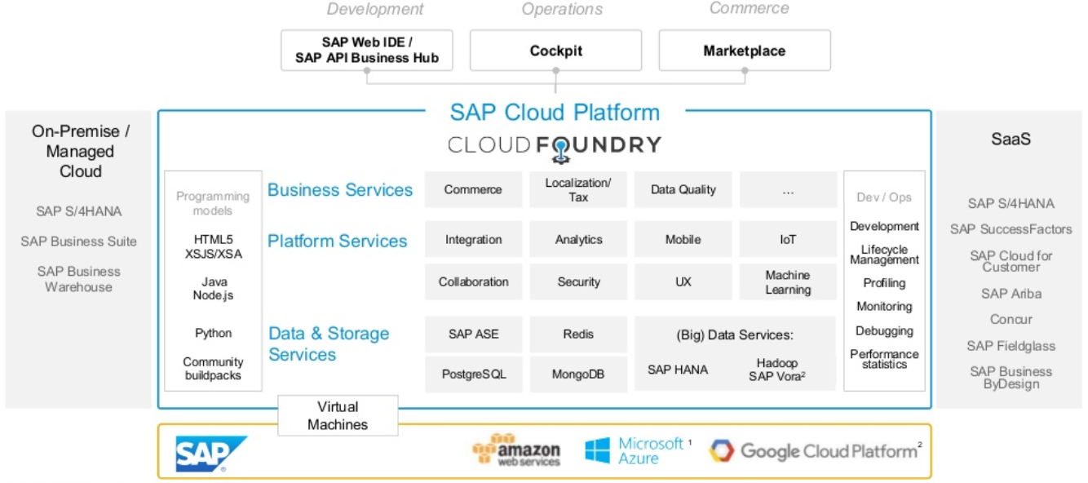
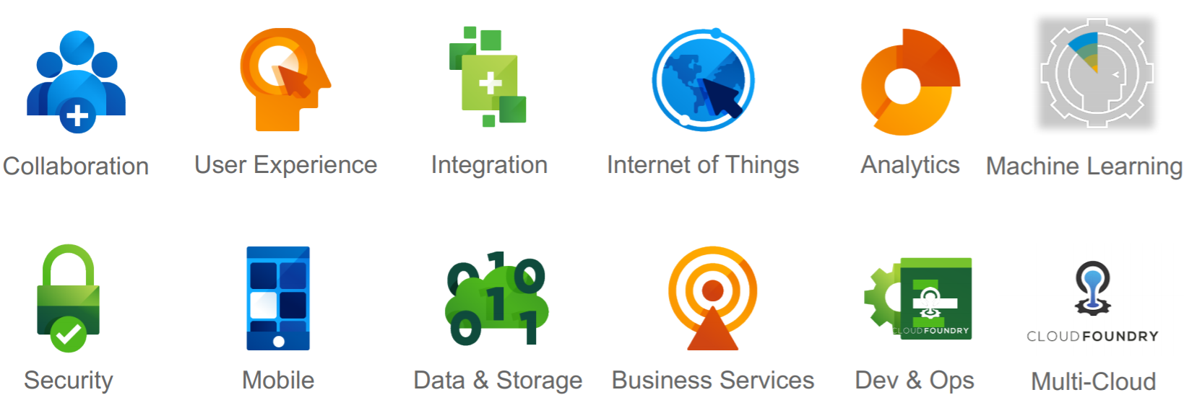
3. SAP Cloud Platform
What is SAP Cloud Platform?
SAP Cloud Platform is an open platform-as-a-service (PaaS) that delivers in-memory capabilities, core platform services, and unique microservices for building and extending intelligent, mobile-enabled cloud applications.
SAP Cloud Platform Capabilities
https://cloudplatform.sap.com/index.html

Slide 6
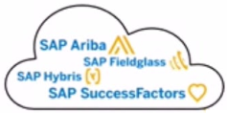
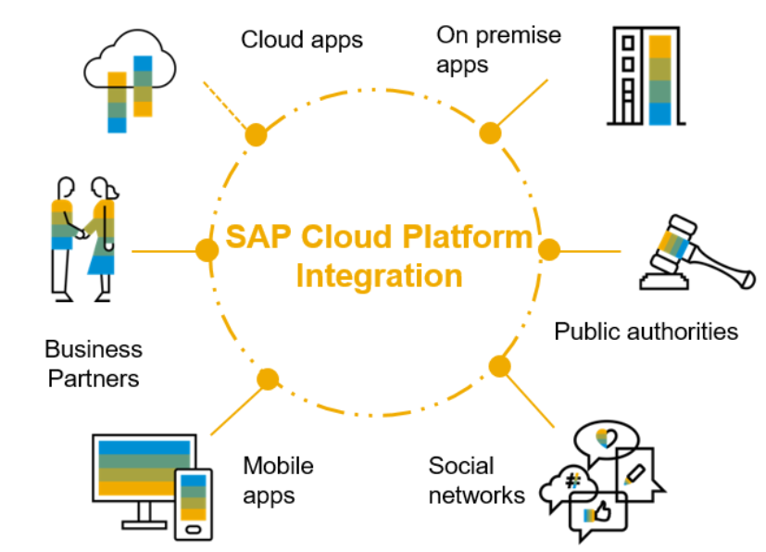
4. SAP Cloud Platform Integration – Overview
Faster innovation, thanks to shorter project and upgrade cycles
Scalable Cloud Integration Platform as the gateway to cloud first strategy
Minimal Upfront Investment
Lower total cost of ownership
SAP Cloud Integration offers many capabilities, including:
Connect any applications:
SAP and non-SAP, Java and ABAP systems
On-premises and in the cloud
Communicate reliably at large scale with enterprise messaging service
Send and receive high number of messages in real-time
Integrate processes and data:
Intra-and inter-company processes with SAP Cloud Platform Integration
ETL between on-premises and cloud repositories
Centralized monitoring and management of integrations.

Slide 7
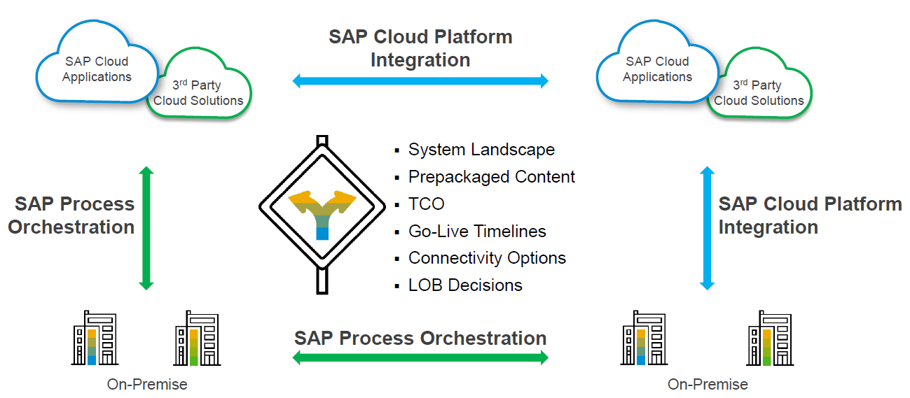
5. SAP CPI vs SAP PI/PO – When to use what? A complementary offering to SAP Process Orchestration

Slide 8
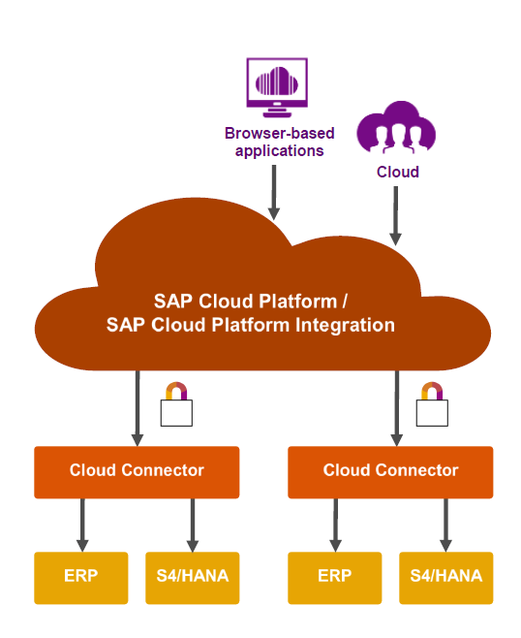

6. SAP CPI to On-premise connectivity
The Cloud Connector allows you to securely connect your on-premise backend systems to the SAP Cloud Platform
Establishes secure SSL tunnel between SAP Cloud Platform and the customer’s on-premise network runs as an on-premise agent and acts as a reverse invoke proxy
DMZ
On-Premise(behind DMZ/Firewall)

Slide 9
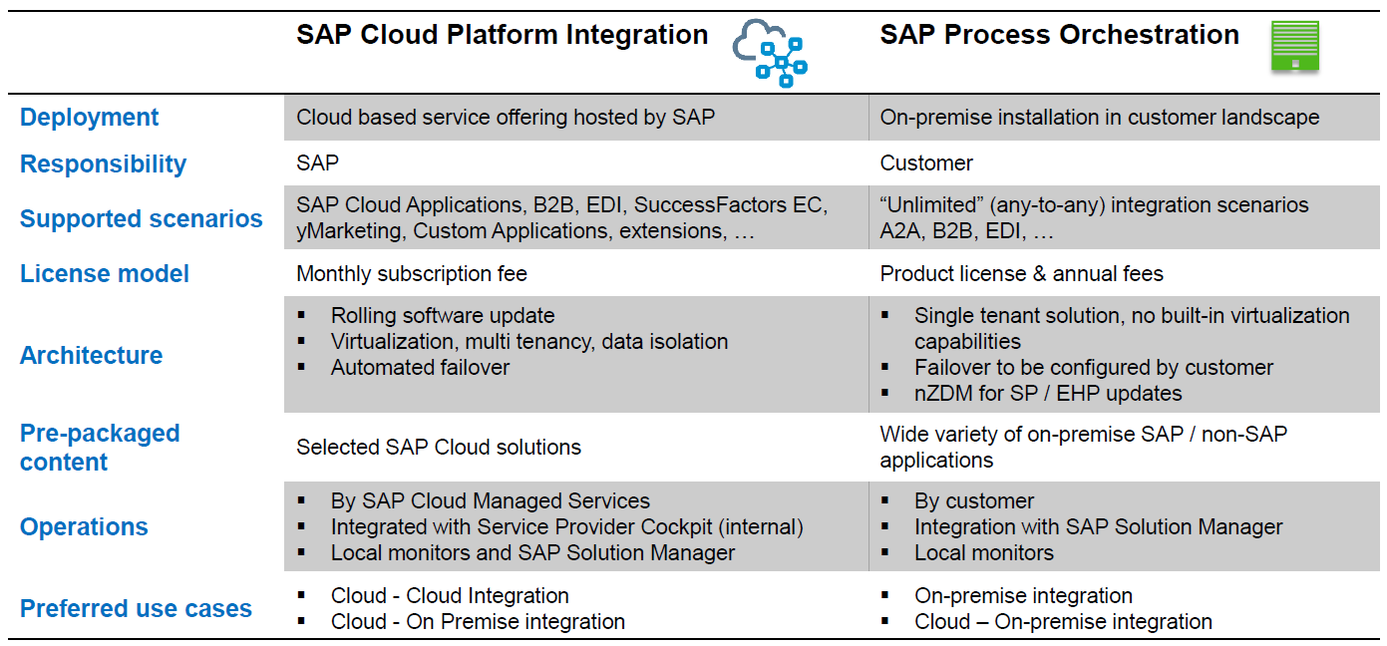
7. Integration Solution Cloud vs. On-Premise

Slide 10
8. Different licencing models and which one is right for your client ?
 | Subscription-based | Consumption-based
Usage | You know the exact services and their usage for your business/projects. | You need the agility to use and consume all the services required for new business initiatives.
Additional Services | You do not expect to add new services during the subscription period. | You need the flexibility to add services and stop usage of other services.
Scalability | You prefer to negotiate upfront and not worry about scaling usage per service. | You want the transparency to see which services are being over and under-utilized.
Self-Service | You prefer paying for a consistent fee for all the contracted services. | You want a self-service approach to adding or stopping services.

Slide 11
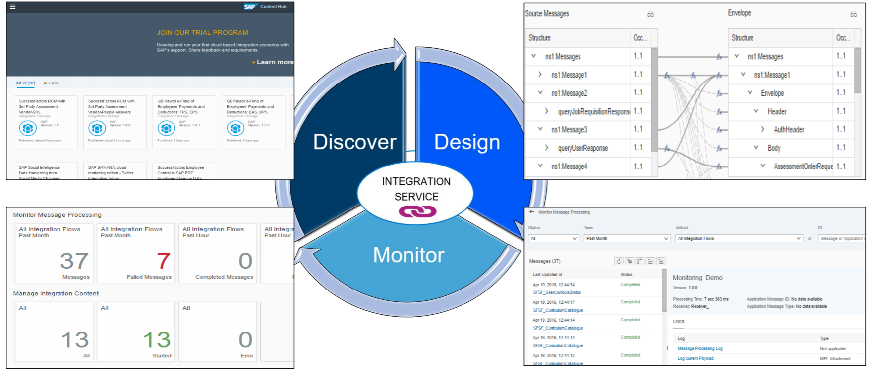
9. SAP Cloud Platform Integration Service

Slide 12
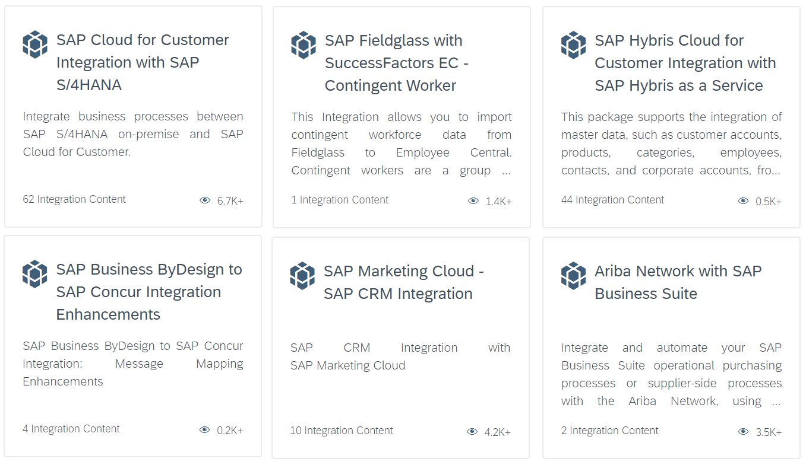
9.1 Discover - Prepackaged CPI contents
SAP provided many pre-packaged APIs and Integration flows for many well know integrations need.
It helps client to jump-start integration projects and quickly complete productive scenarios.
It is more reliable since SAP understands its products and integration need.
Most of the times it is like plug and play for the client with minimal build and testing.
https://api.sap.com/
https://api.sap.com/shell/integration

Slide 13
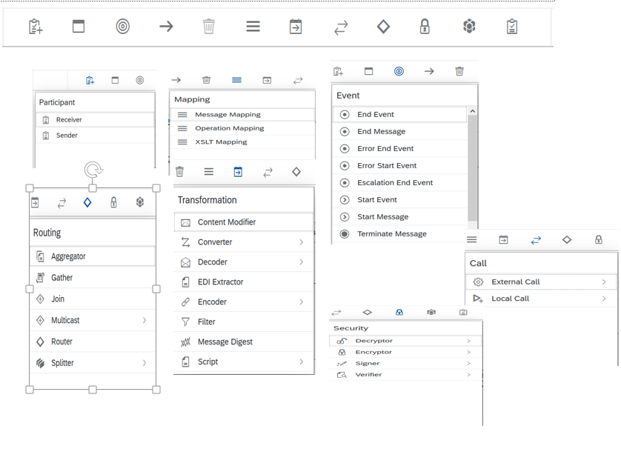
9.2 Design – Integration Content
Flexible design pipeline
Independent and reusable process steps
40+ different steps available
Message Transformation
Message Mapping
Message Routing
Security Elements
Scripting
Tasks
Data Store Operations
Events
Many more…

Slide 14
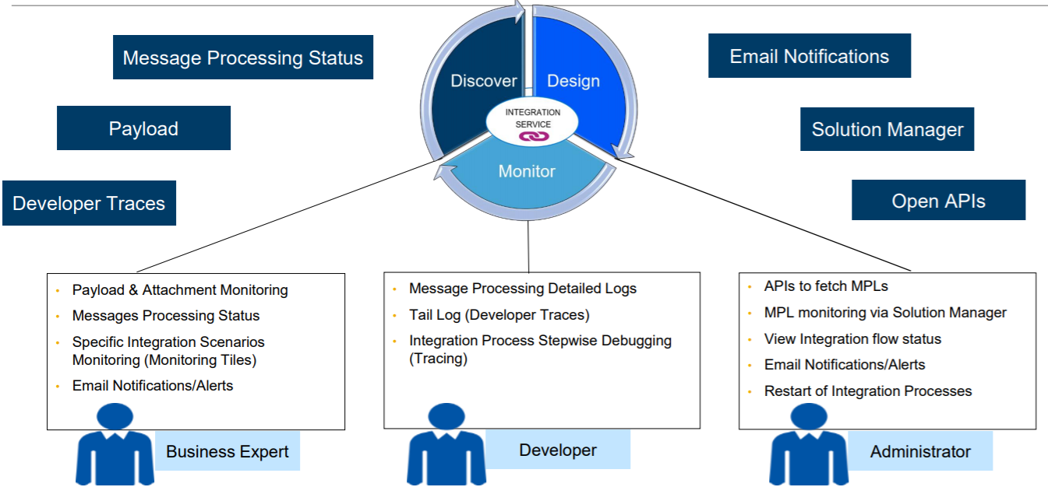
9.3. Monitor – Integration Content

Slide 15


